Slide 1
UM0016 Komunikasi Bisnis
Short Workplace Messages
and Digital Media

Slide 2
Overview
This chapter learn about workplace functions of instant messaging, text messaging, podcasts, wikis, corporate blogs, and social networking sites. Understanding these workplace technologies and best procedures can save you time, reduce blunders, and help you excel as a professional.

Slide 3
Chapter Objectives
Understand the professional standards for the usage, structure, and format of e-mails and interoffice memos in the digital-era workplace.
Explain workplace instant messaging and texting as well as their liabilities and best practices
Identify professional applications of podcasts and wikis
Describe how businesses use blogs to connect with internal and external audiences, and list best practices for professional blogging
Address business uses of social media networks, and assess their advantages as well as risks

Slide 4
Contents
Preparing Digital-Age E-Mail Messages and Memos
Workplace Messaging and Texting
Making Podcasts and Wikis Work for Business
Blogging for Business
Web 2.0: Social Networking

Slide 5
Informational E-Mails and Memos
Writing Plan
◆
Subject Line
Summarize the main idea
Avoid meaningless one-word subject lines.
Type in upper- and lowercase letters.
Do not write as a complete sentence.
NEVER leave the subject line blank.
Instead of these:
Urgent!
we will meet this week
Try these:
Expense Form Due Friday at 5 p.m.
Task Force Meeting Monday, May 28

Slide 6
Informational E-Mails and Memos
Writing Plan
❖
Opening
Frontload: reveal main idea immediately in expanded form.
Instead of this:
Several employees have requested we set up a vanpool.
Try this:
We will meet this Friday at 2 p.m. to discuss a possible company vanpool.

Slide 7
Informational E-Mails and Memos
Writing Plan
⬥
Body
Explain and justify the opening.
Organize information and explanations logically.
Cover just one topic.
Use headings and numbered and bulleted lists to add high “skim value.”

Slide 8
Informational E-Mails and Memos
Writing Plan

Closing
End with one or more of the following:
Action information, dates, or deadlines
Summary of the message
Closing thought
Avoid overused expressions.
Instead of this:
Thank you for your cooperation.
Try this:
Please let me know your answer by Monday, June 2.

Slide 9
Formatting E-Mail Messages
Guide Words
To: | Ann Jones<ajones@peach.com>
From: | Entered automatically
Date: | Entered automatically
Subject: | Meaningful Topic Summary
Cc: | Receiver of copy
Bcc: | Receiver of blind copy
Attached: | Name of file attached

Slide 10

Formatting E-Mail Messages
Salutation Options
No salutation
Ann, Dear Ann:, Hi, or Good morning!
Include name in first line
“Thanks, Ann, for your help . . .”

Slide 11

Formatting E-Mail Messages
Body
Use standard uppercase and lowercase letters.
Cover just one topic.
Try to keep total message under three screens in length.
Double-space between paragraphs.

Slide 12

Formatting E-Mail Messages
Closing
Consider a complimentary closing such as Warm regards or Cheers.
Always type your name at the bottom.
Include full contact identification when needed– especially for messages to outsiders.

Slide 13

Professional E-Mail Messages
Getting Started
Try composing offline.
Type the receiver’s address correctly.
Avoid misleading subject lines.
Apply the top-of-the-screen test.

Slide 14

Professional E-Mail Messages
Content, Tone, and Correctness
Be concise.
Don’t send anything you wouldn’t want published.
Don’t use e-mail to avoid contact.
Care about correctness and tone.
Resist humor and sarcasm.

Slide 15

Professional E-Mail Messages
Netiquette
Never send blanket copies or “spam.”
Use capital letters only for emphasis or for titles.
Don’t forward without permission
Beware of long threads.

Slide 16

Professional E-Mail Messages
Reading and Replying
Scan all messages before replying.
Print only when necessary.
Acknowledge receipt.
Don’t automatically return the sender’s message.
Revise the subject line if the topic changes.
Provide a clear, complete first sentence.
Never respond when you are angry.

Slide 17

Professional E-Mail Messages
Personal Use
Don’t use company computers for personal matters unless allowed by your organization.
Assume that all e-mail is monitored.

Slide 18
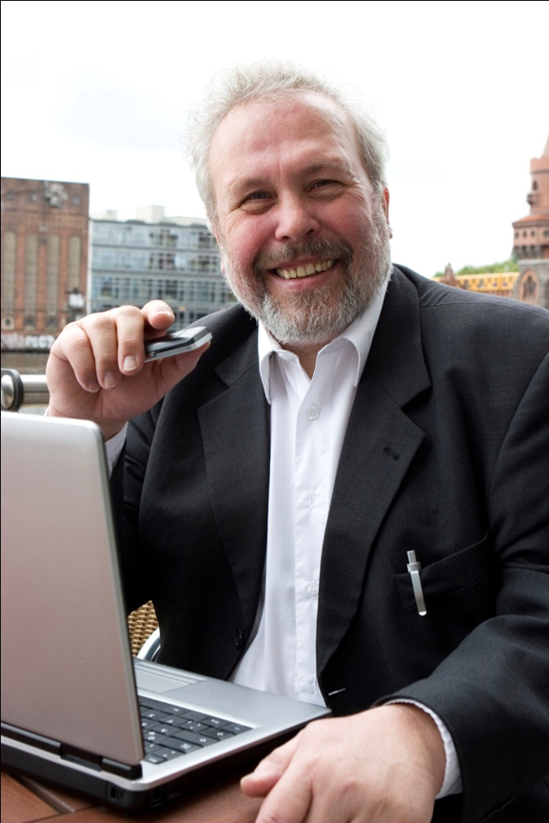
Professional E-Mail Messages
Other Smart Practices
Use design to improve readability of longer messages.
Consider cultural differences.
Double-check before hitting the Send button.

Slide 19
Question & Answers

